Slide 1


Indian
Agricultural
Analysis
Presented by :
G.Guru Charan
MIP-DA-04

Slide 2


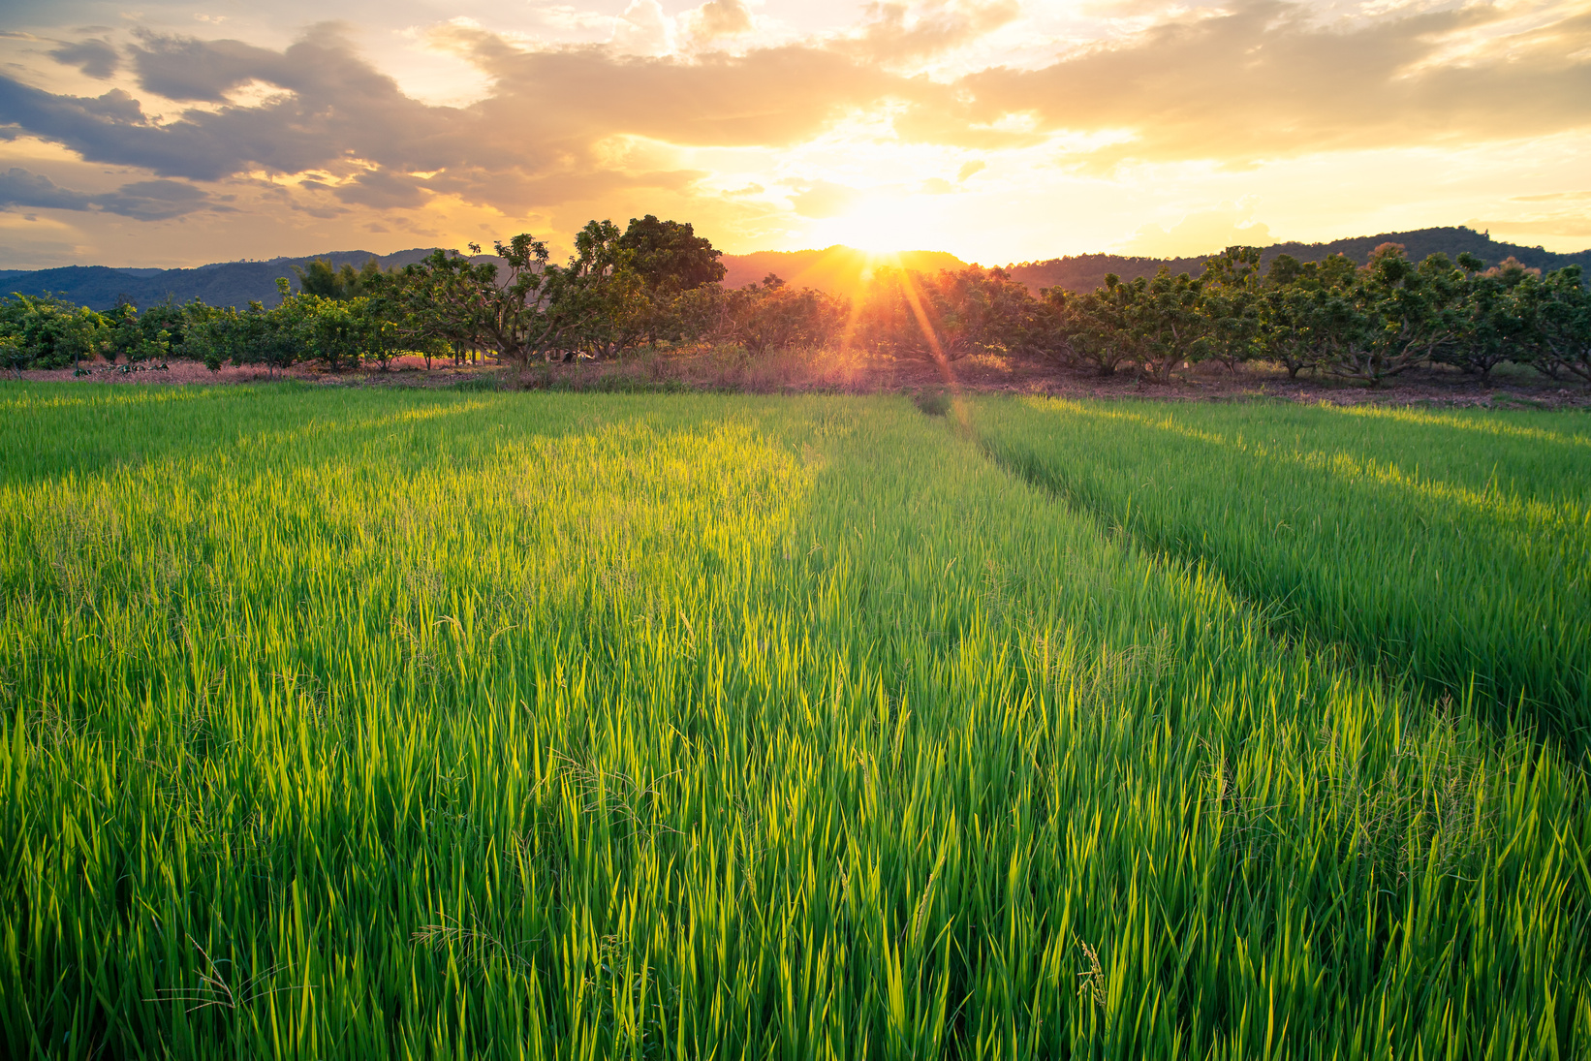
Agenda
Rice
plantations
Rice is mainly grown in rain-fed areas that receive heavy annual rainfall. That is why it is fundamentally a kharif crop in India.
Introduction
Import Data
Data Transformation
Visualization
Wheat plantations
Wheat is a major source of energy and starch, and also contains protein, vitamins, dietary fiber, and phytochemicals.

Slide 3
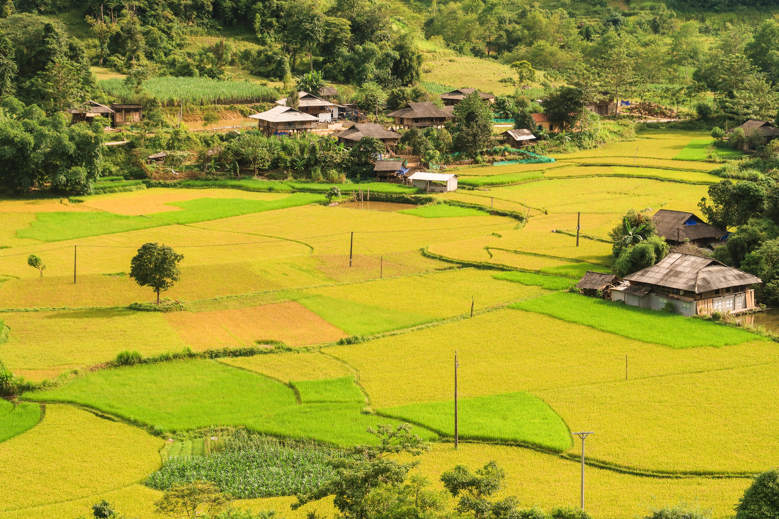

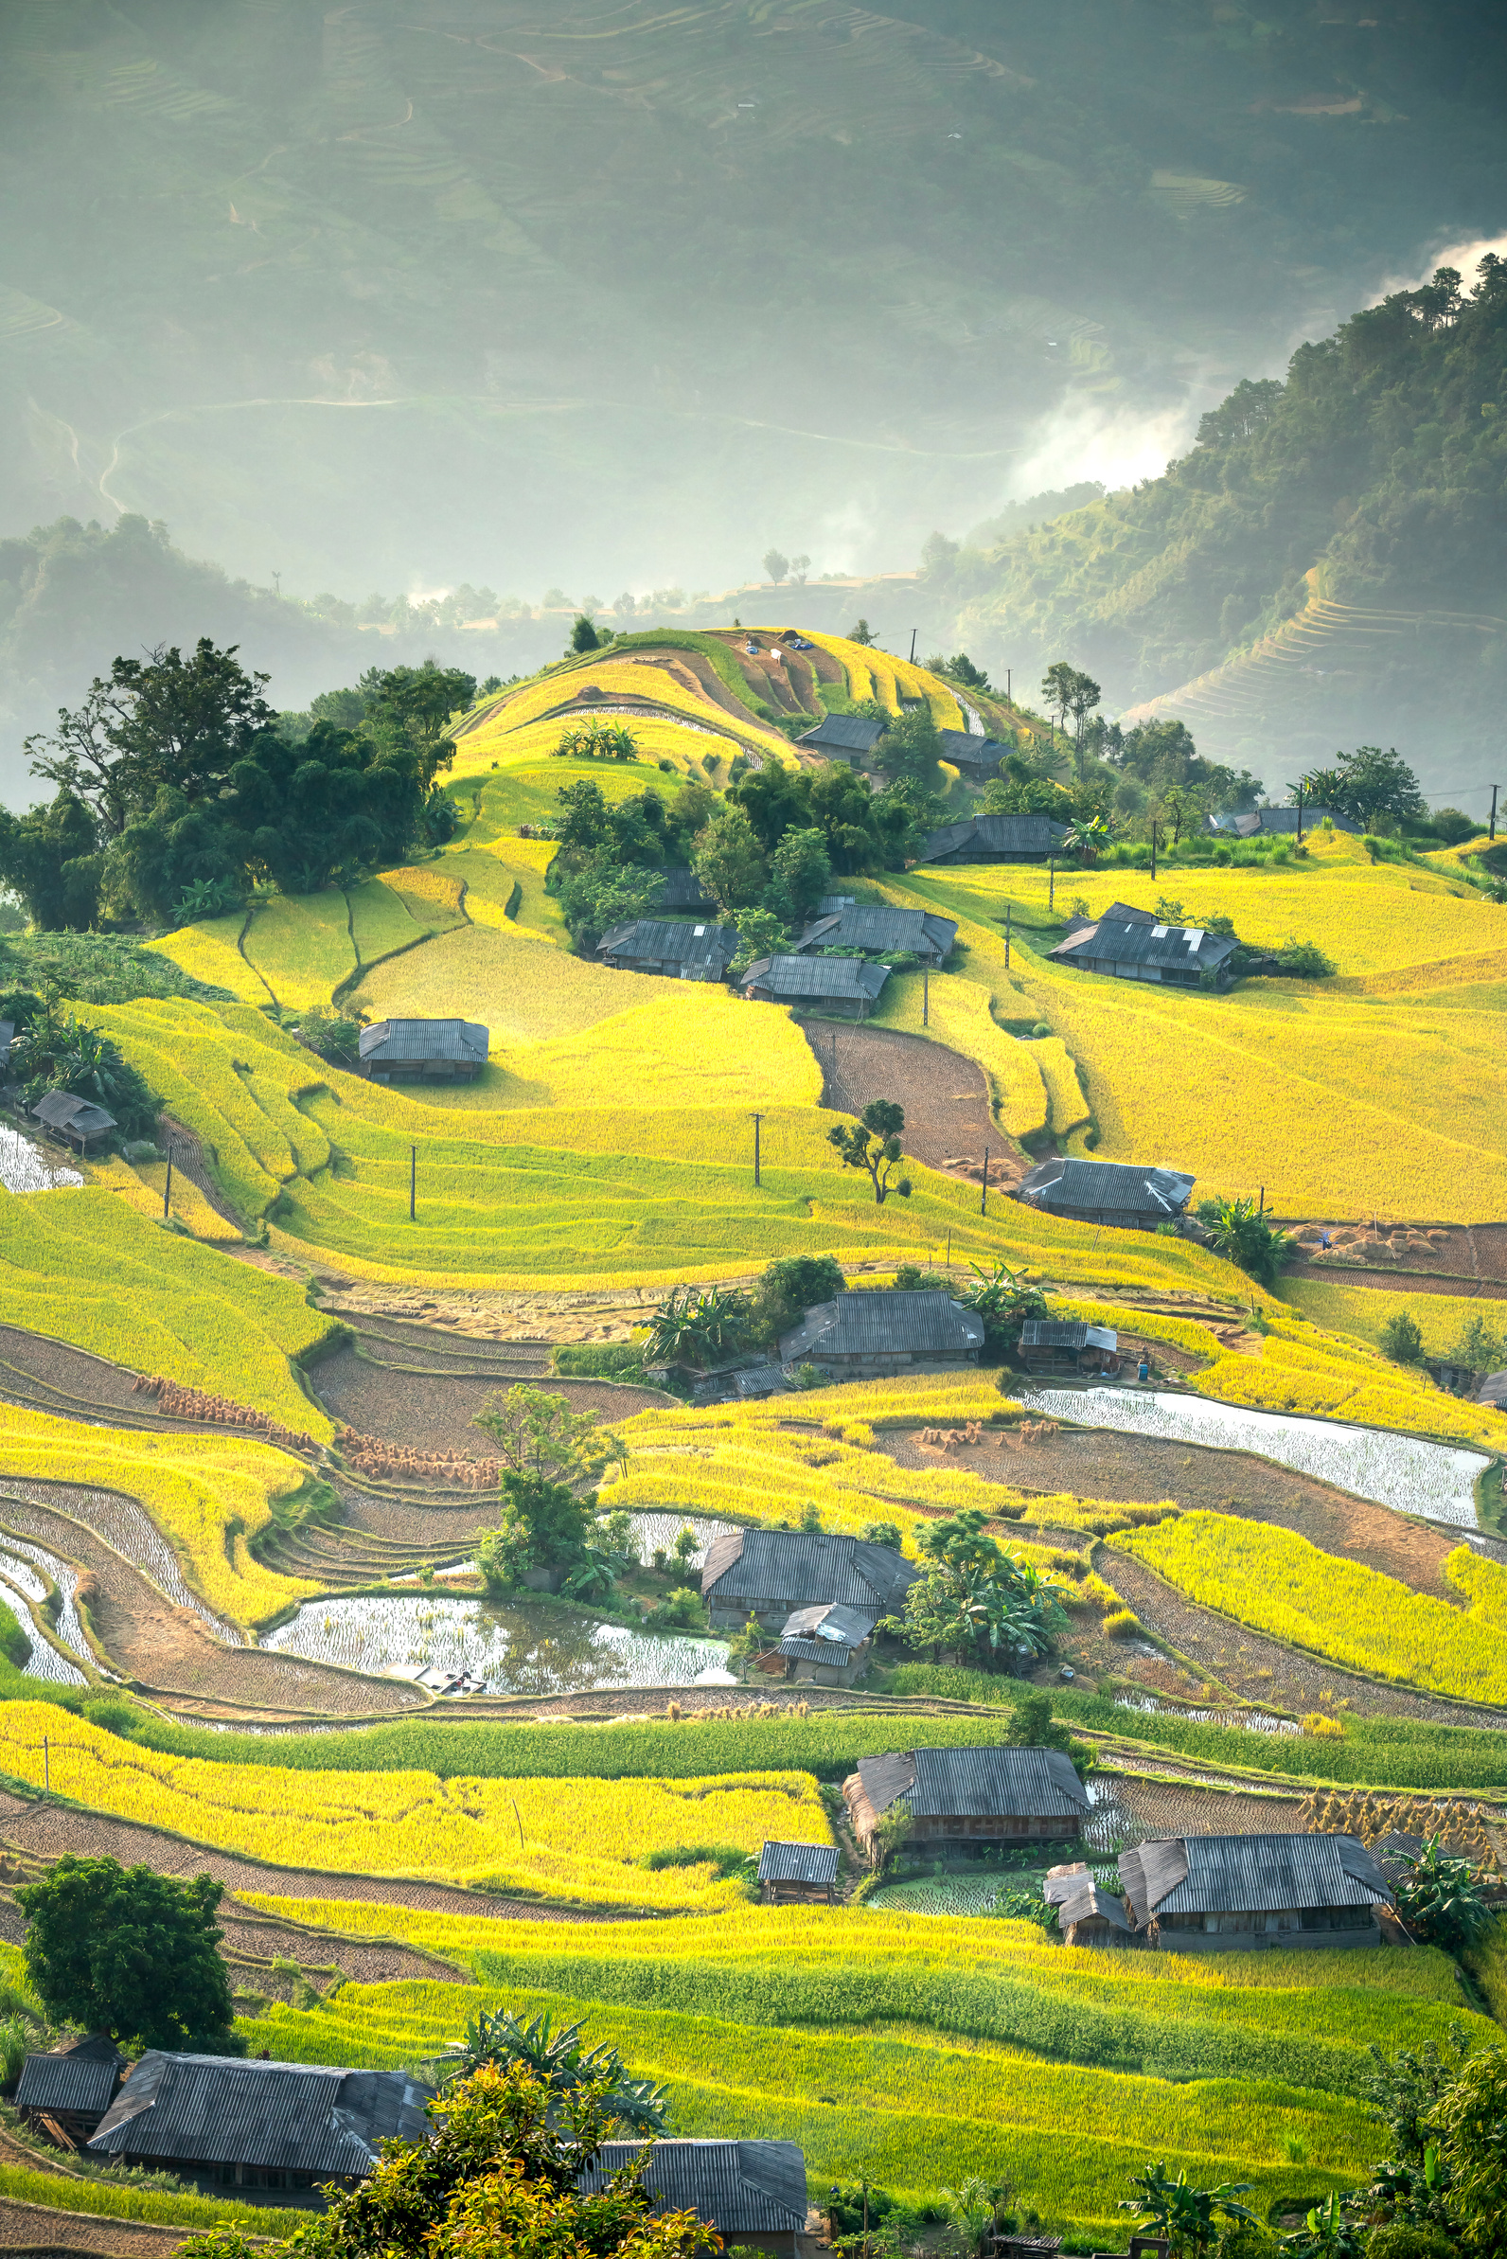
Introduction
The agricultural industry is a series of activities from the production of raw materials, processing, and marketing and distribution as a series of activities in one system.
Farmers manage gardens according to standards to produce and produce quality raw materials
Processing converts raw materials into marketable commodities through conservation and conversion

Slide 4

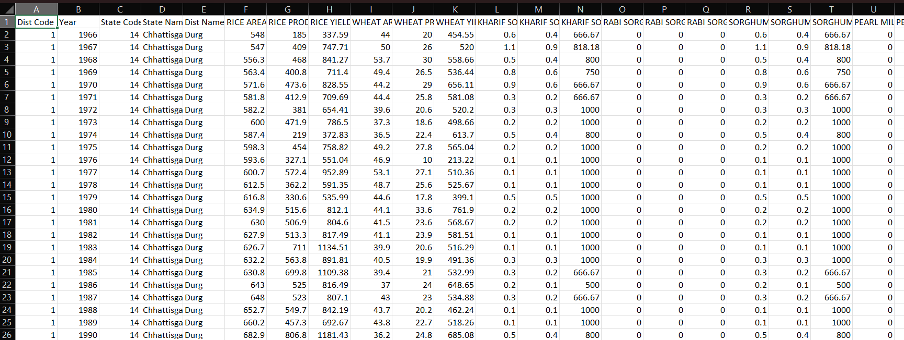
Data
Overview

Slide 5
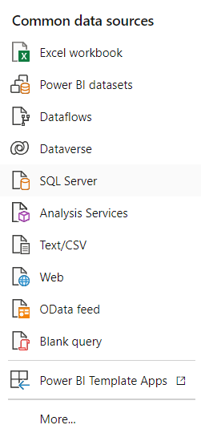
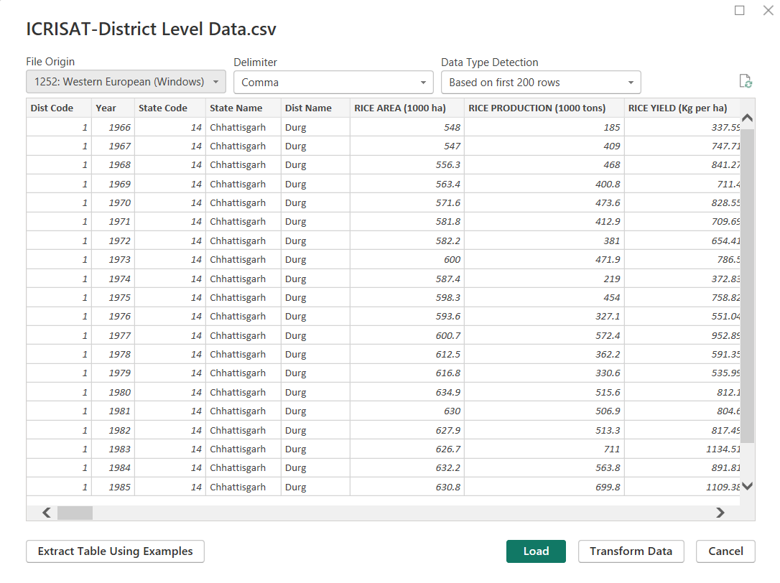

Import Data from CSV to Power Bi

Slide 6
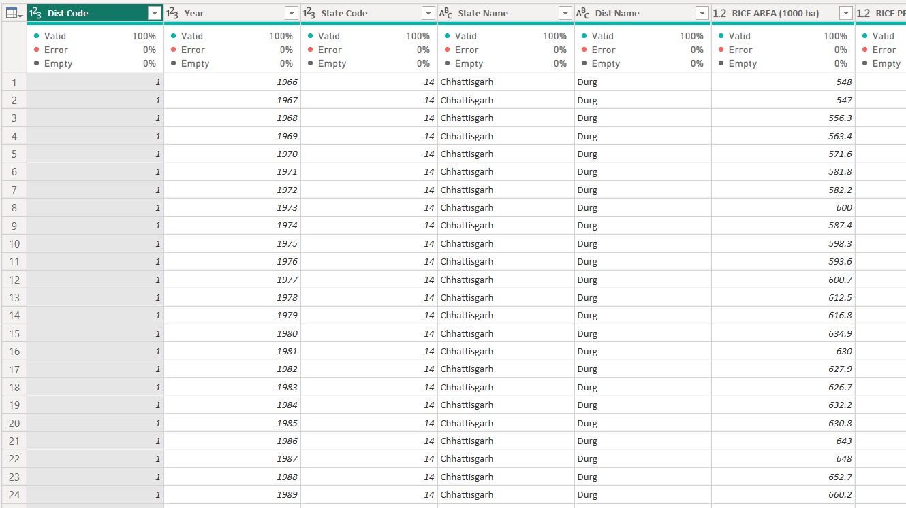
Transform Data into Power Query

Slide 7

Data
Visualization

Slide 8
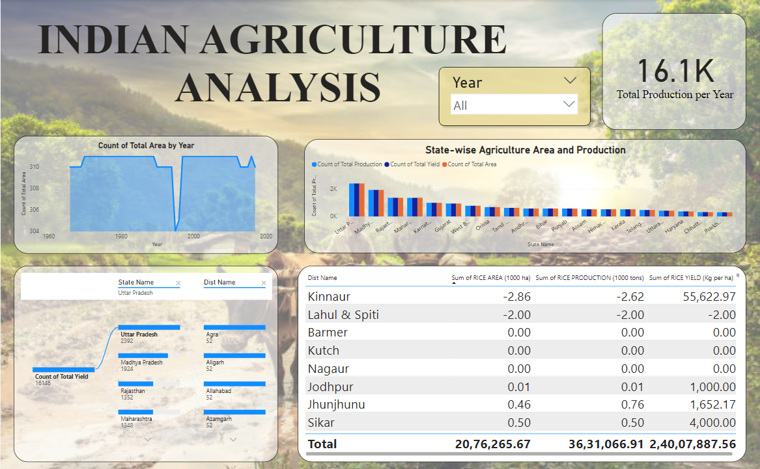

Slide 9
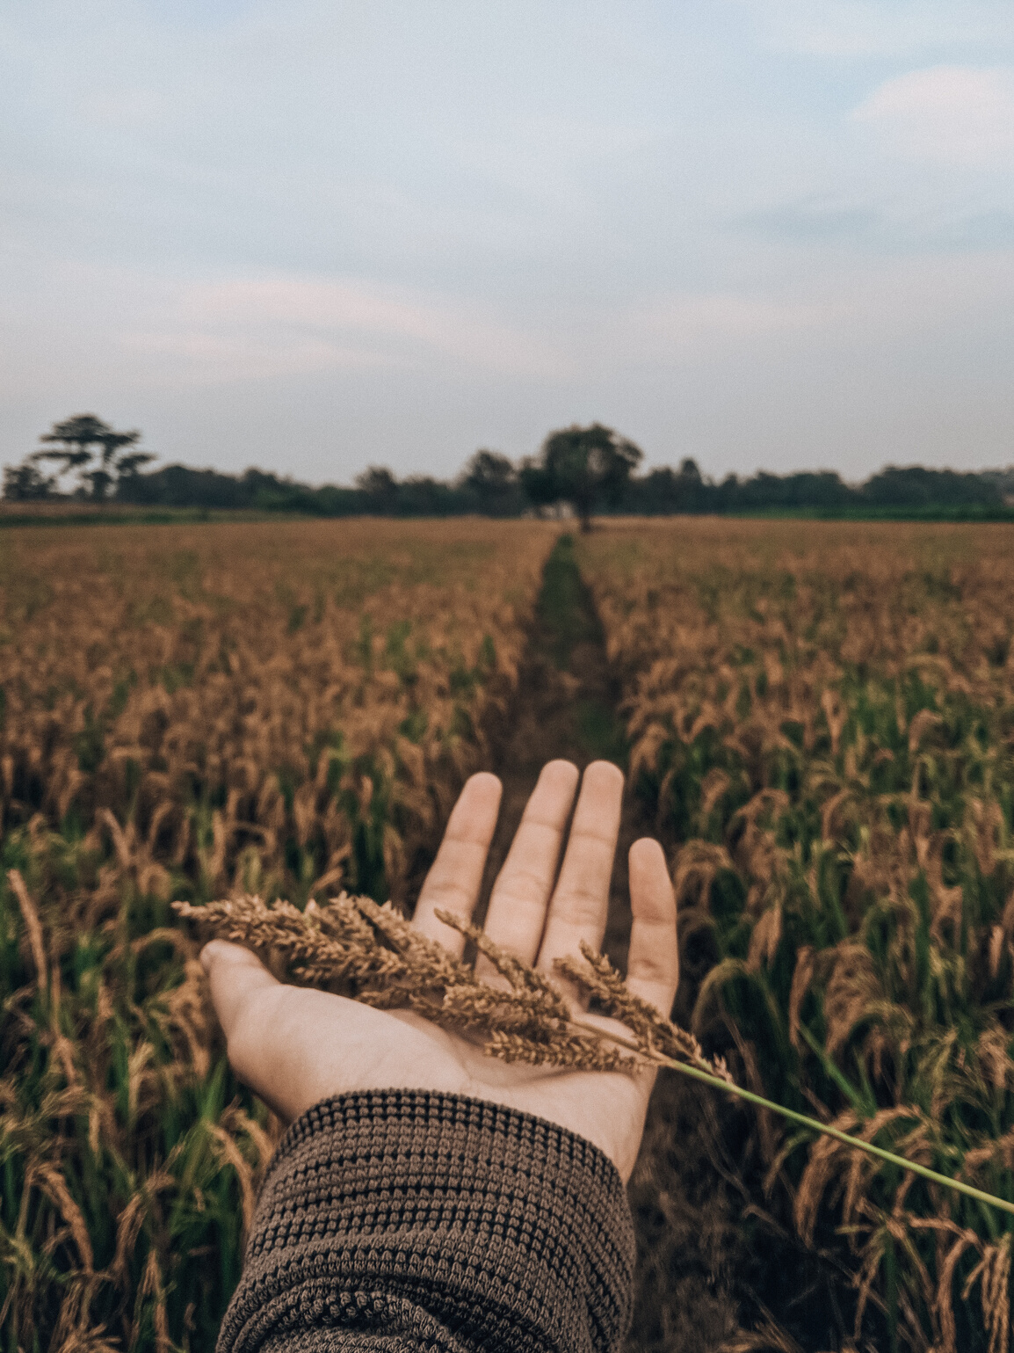
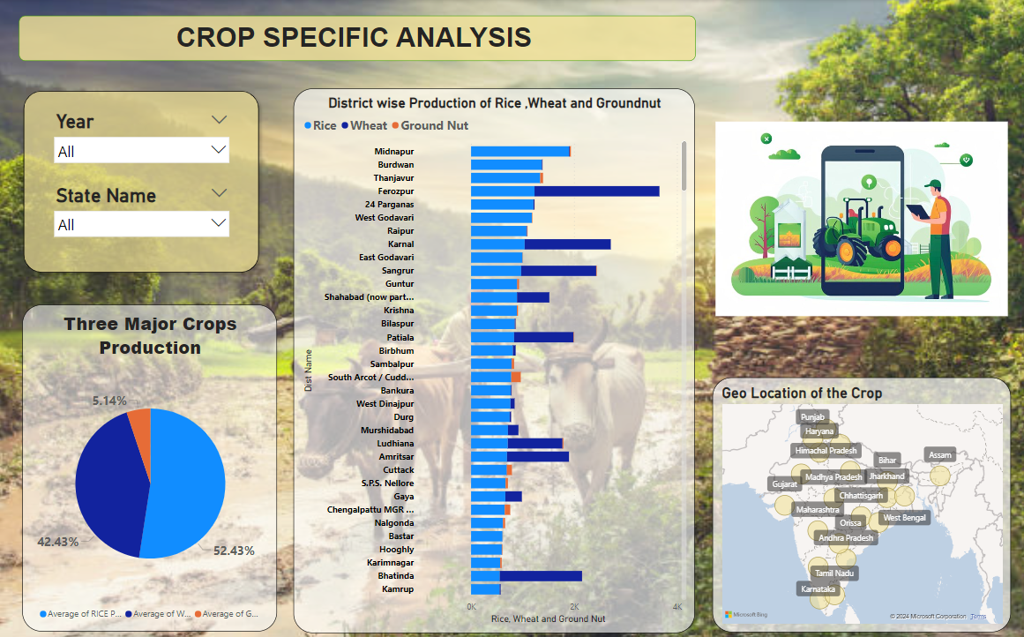

Slide 10
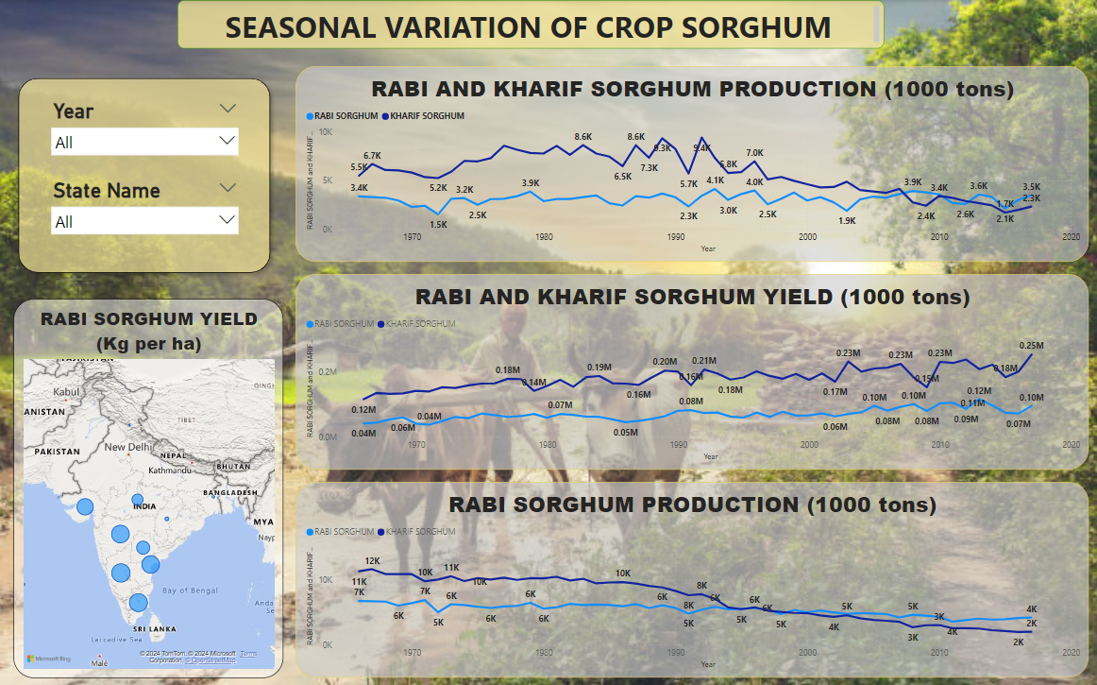

Slide 11
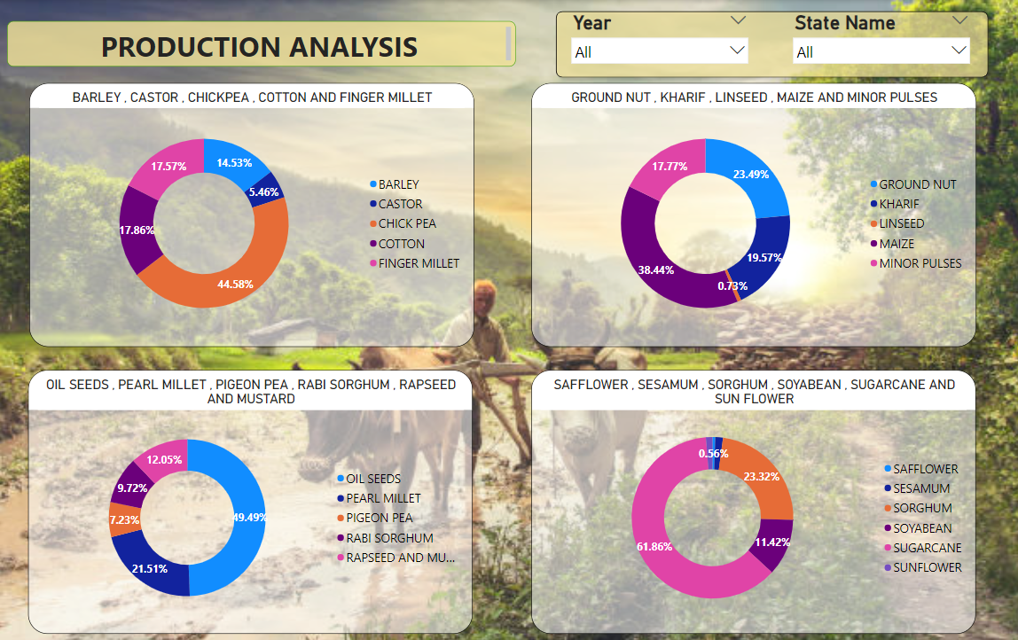

Slide 12
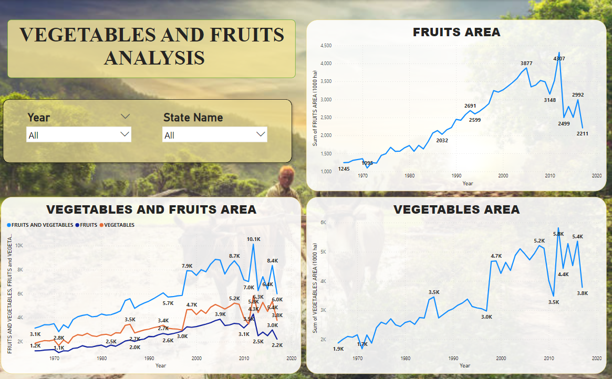

Slide 13
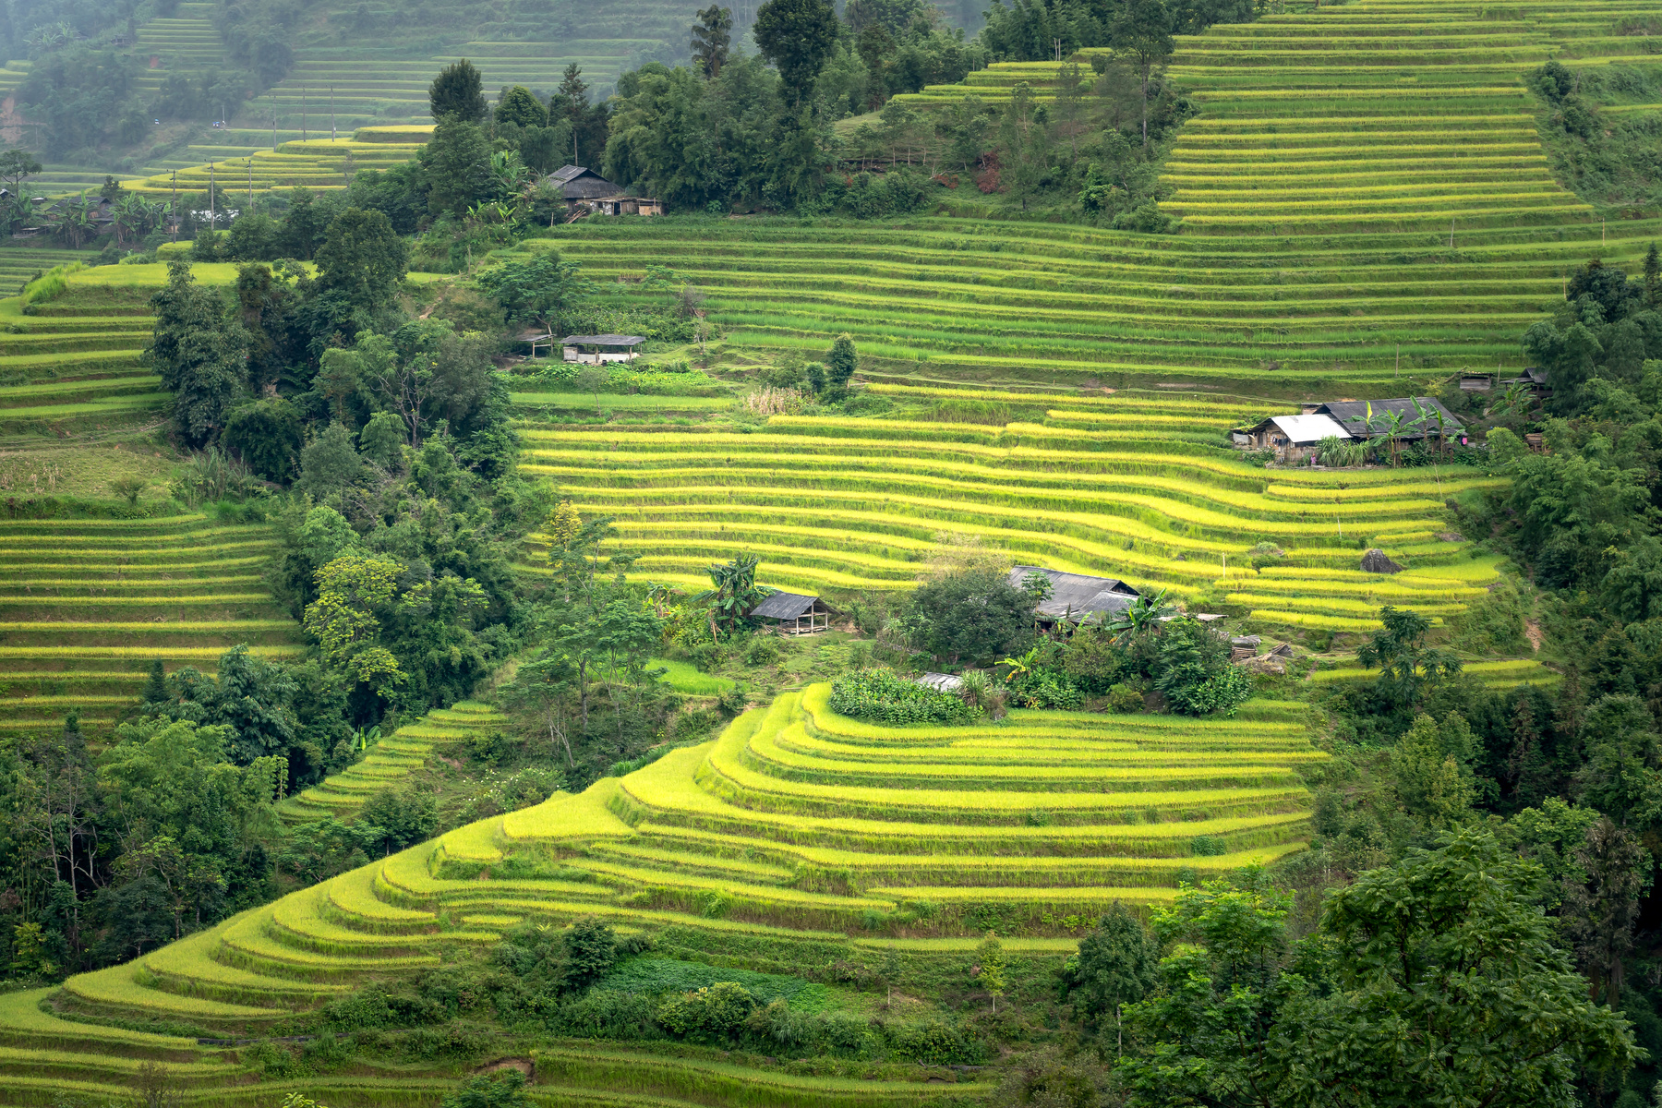
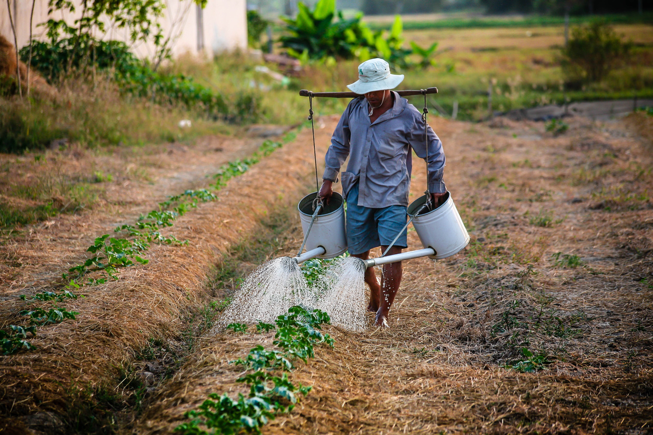
Conclusion
The agricultural industry is a series of activities from the production of raw materials, processing, and marketing and distribution as a series of activities in one system.
Overall, the Indian Agriculture Data Visualization project in Power BI empowers stakeholders with actionable insights, enabling them to enhance agricultural productivity, resilience, and sustainability.

Slide 14



Linked In
guru-charan-gottala
My Email
gurucharan.gottala@gmail.com

Slide 15
Thank
You

